Slide 1
Java Servlet and JSP examples: simple message board
Web Technologies

Slide 2
Example: simple message board
A web application consists of a home page with a list of topics. Each topic has a name. Selecting one topic from the list, a messages page is shown that displays the list of messages for that topic; a message has a date a title and a body. The messages page also contains a link for accessing a message creation page with a form for creating a new message for the previously selected topic, with a given date. Submitting the form leads back to the messages pages, where the newly created message is visible.
Constraint: the input in the message creation form must provide a non empty title and body and a date not before that of today

Slide 3
Data requirements analysis
A web application consists of a home page with a list of topics. Each topic has a name. Selecting one topic from the list, a messages page is shown that displays the list of messages for that topic; a message has a date a title and a body. The messages page also contains a link for accessing a message creation page with a form for creating a new message for the previously selected topic, with a given date. Submitting the form leads back to the messages pages, where the newly created message is visible.
Entities, attributes, relationships

Slide 4
Data requirements analysis
A web application consists of a home page with a list of topics. Each topic has a name. Selecting one topic from the list, a messages page is shown that displays the list of messages for that topic; a message has a date a title and a body. The messages page also contains a link for accessing a message creation page with a form for creating a new message for the previously selected topic, with a given date. Submitting the form leads back to the messages pages, where the newly created message is visible.
Entities, attributes, relationships

Slide 5
Database design
Topic
Message
ID
Title
Body
Date
ID
Name
0:N
1:1
CREATE TABLE `dbtest`.`message` ( `idmessage` INT NOT NULL AUTO_INCREMENT, `title` VARCHAR(45) NOT NULL, `body` VARCHAR(140) NOT NULL, `date` DATE NOT NULL, `topicid` INT NOT NULL, PRIMARY KEY (`idmessage`), CONSTRAINT `message_topic` FOREIGN KEY (`topicid`) REFERENCES `dbtest`.`topic` (`idTopic`) ON DELETE CASCADE ON UPDATE NO ACTION);
CREATE TABLE `dbtest`.`topic` ( `idTopic` INT NOT NULL AUTO_INCREMENT,
`name` VARCHAR(45) NOT NULL, PRIMARY KEY (`idTopic`, `name`));

Slide 6
Application requirements analysis
A web application consists of a home page with a list of topics. Each topic has a name. Selecting one topic from the list, a messages page is shown that displays the list of messages for that topic; a message has a date a title and a body. The messages page also contains a link for accessing a message creation page with a form for creating a new message for the previously selected topic, with a given date. Submitting the form leads back to the messages pages, where the newly created message is visible.
Pages (views), view components, events, actions

Slide 7
Application requirements analysis
A web application consists of a home page with a list of topics. Each topic has a name. Selecting one topic from the list, a messages page is shown that displays the list of messages for that topic; a message has a date a title and a body. The messages page also contains a link for accessing a message creation page with a form for creating a new message for the previously selected topic, with a given date. Submitting the form leads back to the messages pages, where the newly created message is visible.
Pages (views), view components, events, actions

Slide 8
Application requirements analysis
A web application consists of a home page with a list of topics. Each topic has a name. Selecting one topic from the list, a messages page is shown that displays the list of messages for that topic; a message has a date a title and a body. The messages page also contains a link for accessing a message creation page page also contains a with a form for creating a new message for the previously selected topic, with a given date. Submitting the form leads back to the messages pages, where the newly created message is visible.
Pages (views), view components, events, actions

Slide 9
Application requirements analysis
A web application consists of a home page with a list of topics. Each topic has a name. Selecting one topic from the list, a messages page is shown that displays the list of messages for that topic; a message has a date a title and a body. The messages page also contains a link for accessing a message creation page with a form for creating a new message for the previously selected topic, with a given date. Submitting the form leads back to the messages pages, where the newly created message is visible.
Pages (views), view components, events, actions

Slide 10
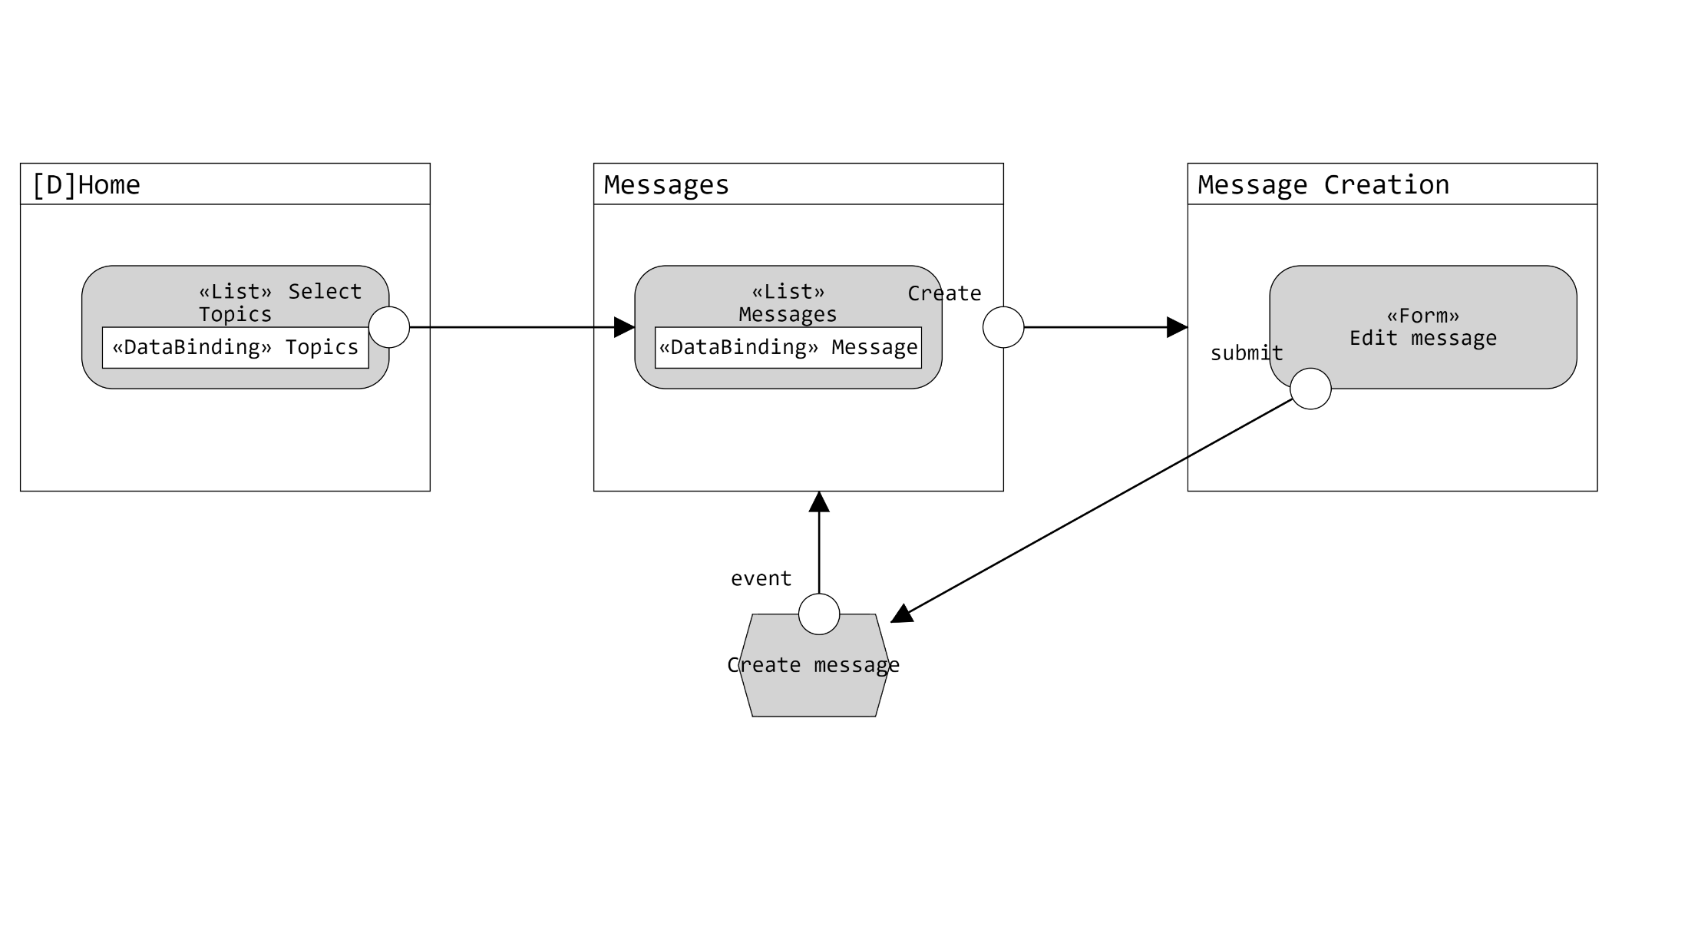
Application design (in IFML)

Slide 11

Architecture
Web tier
Model View Controller (MVC)
Controller: handles event
View= presents the interface
Model: store the application status
Business & data tier
If complex business logic is required, a service layer can be interposed between the controllers and the DAO layer , to make DAO cope only with data access
request
response
Controllers
Views
read
redirect/forward
invoke
Model Objects
create
Data Access Objects
resultSet
executeQuery
executeUpdate
Database

Slide 12
Components
Model objects (Beans)
Topic
Message
Data Access Objects (Classes)
TopicDAO
findAllTopics
findTopicById
MessageDAO
findMessagesOfTopic
createMessage
Controllers (servlets)
GetTopics
GetMessagesByTopic
CreateMessage
Views (Templates)
Home.jsp
ShowMessages.jsp
CreateMessage.jsp
The database connection is created by controllers in the init() method and passed to the DAO

Slide 13
Events: access to home
@WebServlet("/GetTopics")
GetTopics
TopicDAO
request
Home.jsp
findAllTopics
doGet
topics
setAttribute ("topics", topics)
forward

Slide 14
Events: selection of topic
@WebServlet("/GetMessagesOfTopic")
GetMessagesOfTopic
MessageDAO
TopicDAO
request
ShowMessages.jsp
GET /GetMessagesByTopic
?topicid=X
findMessages OfTopic(X)
doGet
messages
findTopic ById(X)
t
setAttribute ("messages", messages)
setAttribute ("topic", t)
forward
PS: error handling for inexistent topic omitted for brevity

Slide 15
Events: access to the creation page
@WebServlet("/CreateMessage")
createMessage
TopicDAO
request
CreateMessages.jsp
GET /createMessage?topicid=X
doGet()
findTopicById(X)
t
setAttribute("topic", t)
forward
PS: error handling for inexistent topic omitted for brevity

Slide 16
Events: creation of message
@WebServlet("/CreateMessage")
CreateMessage
MessageDAO
GetMessages OfTopic
Response
doPost()
alt
[ ... No errors...]
POST /CreateMessage
Title → t
Body → b
Date → d
TopicID → tid
CreateMessage (t,b,d,tid)
Redirect /GetMessagesOfTopic? topicid= tid
[else]
sendError(error)

Slide 17
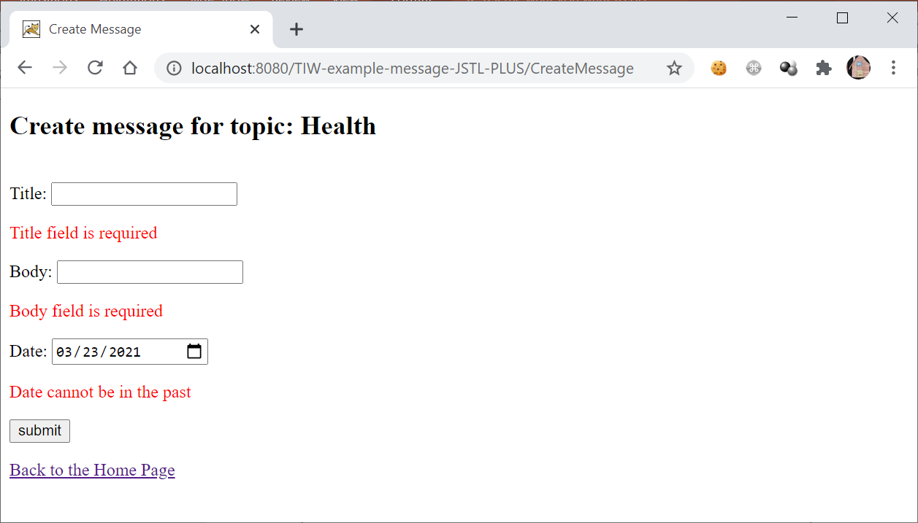
Extended specifications
Improve the control that checks the form input for the creation of a message. If there is/are errors, redisplay the form showing the previous input and error message(s) associated to the wrong value(s)

Slide 18
New component
MessageForm bean
It «objectifies» the input of the user in the createMessage form
One data member for each input field
It provides a method isValid() to check if the input is correct
It holds the text of the error messages for each constrained input field
It is produced by the doPost() method of the createMessage controller and consumed by the createMessage.jsp view template

Slide 19
Events: creation of message
CreateMessage
msg: MessageForm
MessageDAO
GetMessages OfTopic
Request
Create Message.jsp
doPost()
«create»
alt
POST /CreateMessage
Title → t
Body → b
Date → d
TopicID → tid
[msg.isValid()]
CreateMessage (t,b,d,tid)
Redirect /GetMessagesOfTopic? topicid=" + tid
[else]
setAttribute("messageForm", msg)
setAttribute("topic", topic)
forward

Slide 20
To do
Possible improvements
Modify the View ShowMessages.jsp (and any other necessary component) to place an icon on the row of the newly generated message (only after a new message is created)

Slide 21
References
https://editor.ifmledit.org/

